Slide 1
TEAM NATURAL INTELLIGENCE msds6306: DOING DATASCIENCE Case Study 2
MICHAEL J WOLFE
AYOADE G DARE

Slide 2



DDSANALYTICS INC.
TALENG MANAGEMENT PROJECT

Slide 3
TABLE OF CONTENTS
PROBLEM STATEMENT
EXPLORATORY DATA ANALYSIS
METHOD: RANDOM FOREST ALGORITHM
OBSERVATIONS
RECOMMENDATIONS
CONCLUSION

Slide 4
PROBLEM STATEMENT
Reduce employee turnover (attrition)
Improve talent management process to develop and retain employee
Identify top three factors that contribute to turnover
Identify job role trends that exist in the data set

Slide 5
Deliverables
Exploratory Data Analysis
Machine Language Algorithm Comparison
Machine Learning Model Optimization & Fine-Tuning
Turnover (attrition) Prediction
Recommendation

Slide 6
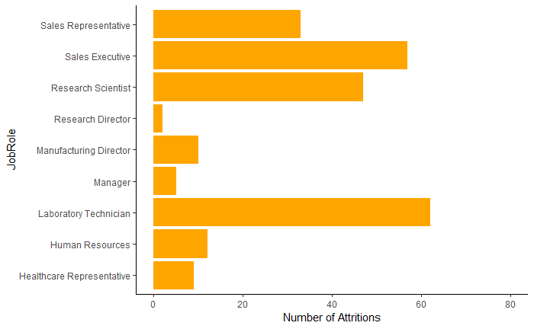
Exploratory data analysis

Slide 7
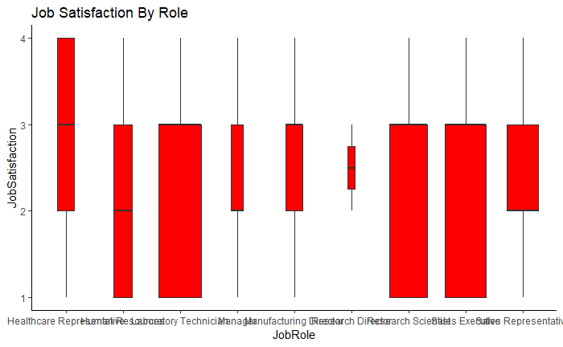
Exploratory data analysis

Slide 8
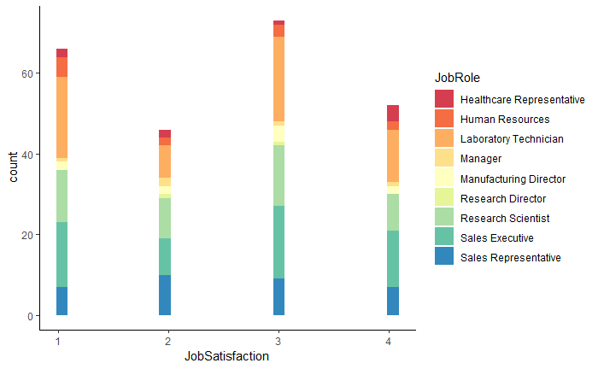
Exploratory data analysis

Slide 9
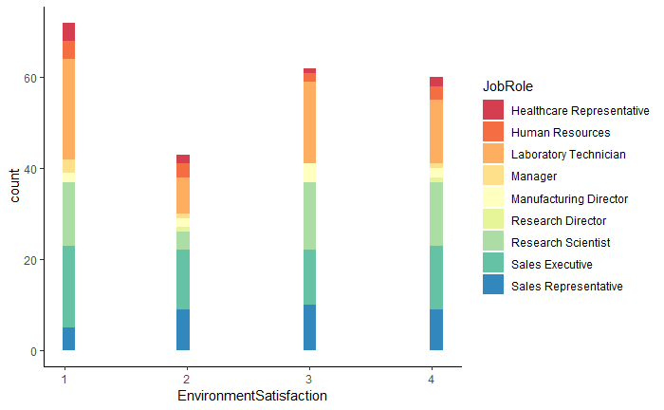
EXPLORATORY DATA ANALYSIS

Slide 10
Method
We opted for a random forest algorithm to select the top 3 variables
This method iterates through multiple permutations of variables to determine if certain combinations produce expected results
This is a powerful tool for exploring data and learning how features affect outcomes

Slide 11
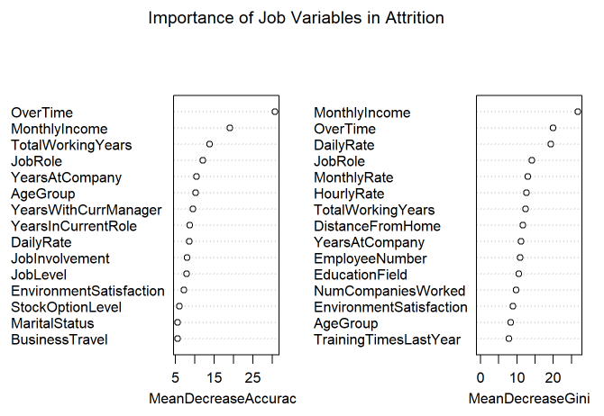
OBSERVATIONS from Random forest
 | Yes Importance | Mean Decrease Accuracy | Mean Decrease Gini
OverTime | 32.14 | 30.70 | 19.90
MonthlyIncome | 15.21 | 19.07 | 26.81
JobLevel | 7.53 | 7.85 | 3.36
TotalWorkingYears | 7.28 | 13.80 | 12.34
JobInvolvement | 7.08 | 7.93 | 7.84
DailyRate | 6.92 | 8.54 | 19.36
EnvironmentSatisfaction | 6.19 | 7.21 | 8.98
JobRole | 4.69 | 12.02 | 14.13

Slide 12
OBSERVATIONS From Logistic Regression
Term | Estimate | std.error | statistic | p.value
(Intercept) | -0.5231823 | 0.2259298 | -2.315685 | 0.0205755
MonthlyIncome | -0.0001402 | 0.0000227 | -6.185634 | 0.0000000
EnvironmentSatisfaction | -0.3396194 | 0.0693113 | -4.899914 | 0.0000010
OverTimeYes | 1.4741367 | 0.1538107 | 9.584095 | 0.0000000
Term | Statistic
llh | -571.7344869
llhNull | -649.2913504
G2 | 155.1137270
McFadden | 0.1194485
r2ML | 0.1001431
r2CU | 0.1707119

Slide 13
Other OBSERVATIONS
 | No Importance | Mean Decrease Accuracy | Mean Decrease Gini
OverTime | 18.83 | 30.70 | 19.90
MonthlyIncome | 11.97 | 19.07 | 26.81
TotalWorkingYears | 11.36 | 13.80 | 12.34
JobRole | 10.84 | 12.02 | 14.13
AgeGroup | 9.35 | 10.19 | 8.30
YearsWithCurrManager | 8.70 | 9.51 | 7.60
YearsAtCompany | 8.61 | 10.42 | 11.17
YearsInCurrentRole | 7.34 | 8.66 | 5.04
Term | Estimate | Standard Error | Statistic | P Value
(Intercept) | -1.2576143 | 0.1533876 | -8.198929 | 0.0000000
MonthlyIncome | -0.0000681 | 0.0000309 | -2.204935 | 0.0274586
TotalWorkingYears | -0.0540751 | 0.0174504 | -3.098782 | 0.0019432
OverTimeYes | 1.3964687 | 0.1508408 | 9.257896 | 0.0000000
Term | Statistic
llh | -578.7809665
llhNull | -649.2913504
G2 | 141.0207678
McFadden | 0.1085959
r2ML | 0.0914747
r2CU | 0.1559349

Slide 14
CONCLUSION/rECOMMENDATIONS
The random forest/GLM model have revealed surprising results
Decision trees recommended results that yielded little variance in a statistical model
Most of the training data was mocked up by us
Obtaining more data to properly test and adjust our model will produce more predictive results

Slide 15
QUESTIONS

